Slide 1
JAVASCRIPT AND DHTML
Continuing Education, University of Calgary
Adnan Ahmed (aeahmed@ucalgary.ca)

Slide 2
JavaScript – call from HTML
JavaScript functions can be called from HTML
  e.g when a page loads or a page unloads (when user leaves the page)
    onLoad
    onUnload
  Supported by the following html tags:
    <body>
    <frameset>

Slide 3
JavaScript – call from HTML
JavaScript File
function callMeOnLoad()
{
alert(“I am loaded”);
}
html File
<html>
<body onLoad = “javaScript:callMeOnLoad()”>
</body>
</html>

Slide 4
JavaScript Events
To call a JavaScript function when the page loads:
  <body onload=“yourFunctionName()">
  or
  <body onload=“javascript:yourFunctionName()">

Slide 5
JavaScript Events
Onload and onUnload is only supported by the body tag
write a different function called callMeOnUnload()
call it when you leave the page (<body onunload)

Slide 6
JavaScript Events
you can call javaScript function from a link in two ways
  <a href = “javascript:showMeNum(3);”>show</a>
  or
  <a href = http://google.com onclick=“showMeNum(3)”>show</a>

Slide 7
JavaScript Events
onFocus, onBlur and onChange
  used with form elements
<input type="text" onChange=“alert('a');" name="fname" size="20">
do a different event for onblur and onchange
onBlur and onFocus doesn’t work very well with Firefox

Slide 8
JavaScript Events
onSubmit()
  used to validate form submission
<input type="submit" value="Submit" onsubmit="return checkForm()">
or
<input type="submit" value="Submit" onsubmit="checkForm()">

Slide 9
JavaScript Events
onSubmit()
  used to validate form submission
<form name="myform" action="submit.html" onsubmit="return checkForm()">
or
<form name="myform" action="submit.html" onsubmit=“checkForm()">

Slide 10
JavaScript Events
onReset()
  works the same way as the onSubmit
  is used with the form tag
  called when the reset button of the form is clicked

Slide 11
JavaScript Events
onmouseover and onmouseout
<img src = "images\earth.jpg" onmouseover = "alert('this is earth')">
do a different alert for onmouseout

Slide 12
JavaScript Events
onMouseUp and onmouseDown
  when the mouse button is pressed up or down.
<img src=“images\moon.jpg"
onmouseup="alert(‘mouse up')">
<img src="images\world.jpg "
onmousedown="alert(‘mouse down’)”>

Slide 13
JavaScript Events
onMouseMove
  happens when the mouse pointer moves
  by default, not an event of any object
  <img src=“world.jpg“ onmousemove="alert(‘mouse moved')" />

Slide 14
JavaScript Events
onKeyDown and onKeyUp
  occurs when a keyboard key is pressed and released.
  supported by
    document
    image
    link
    textarea
<input type="text"
id="fname" onkeyup=“alert(‘key up’)">

Slide 15
JavaScript Events
onKeyPress
  <input type="text" onkeypress=“alert(‘key pressed’)" />

Slide 16
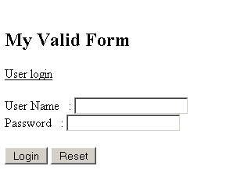
Validate a form
Task:
  a form with two input boxes
  one for username
  one for password
  a submit button
  a reset button

Slide 17
Validate a form
The form should call a validation Function when submitted
The validation function will check that the text boxes are not empty. If they are empty then
  submission will be cancelled
  show error message to user
If the text boxes are not empty
  check if the user name and password are valid
  if valid then submit the form
  else cancel submission and show error message to user

Slide 18
Before we validate
To validate the form we will need to access the form elements using DOM level 0.
Lets talk about DOM then

Slide 19
DOM
The Document Object Model (DOM) is the model that describes how all elements in an HTML page
  input fields
  images
  paragraphs
  buttons
  div etc..
are related to the topmost structure: the document itself.

Slide 20
DOM
JavaScript has the ability to access and manipulate these Elements of the DOM
Three levels of DOM
  The Level 0 DOM, supported from Netscape 2 onwards by all browsers.
  The two Intermediate DOMs, supported by Netscape 4 and Explorer 4 and 5. Use of these DOMs is not necessary any more and should be ignored
  The Level 1 DOM, or W3C DOM, supported by Mozilla and Explorer 5

Slide 21
DOM
Level 0 DOM
  invented by Netscape at the same time JavaScript was invented and was first implemented in Netscape 2.
  It offers access to a few HTML elements, most importantly forms and images.
  For reasons of backward compatibility the more advanced browsers, still support Level 0 DOM.
  Level 0 DOM doesn't entirely fit into the new DOM concepts

Slide 22
DOM
Intermediate DOMs
  Not important anymore
  You don’t it either
  included browser specific implementation such as
    document.layers (netscape)
    document.all (microsoft)

Slide 23
DOM
Level 1 DOM
  an exact model for the entire HTML / XML
  it is also possible to change the document on the fly, take out a paragraph and change the layout of a table, for instance.

Slide 24
DOM – Accessing Elements
Using DOM 0 we can access an image with name = “first” using:
  document.images['first']

Slide 25
DOM – Accessing Elements
DOM 0 supports the following node lists
  document.images[], which grants access to all images on the page.
  document.forms[], which grants access to all forms on the page.
  document.forms[].elements[], which grants access to all form fields in one form, whatever their tag name.
  This nodeList is unique to the Level 0 DOM; the W3C DOM does not have a similar construct.

Slide 26
DOM – Accessing Elements
DOM 0 supports the following node lists
  document.links[], which grants access to all links (<a href>) on the page.
  document.anchors[], which grants access to all anchors (<a name>) on the page.

Slide 27
DOM – Accessing Elements
When the browser concludes that an HTML document has been completely loaded
  it starts making arrays.
  It creates the array document.images[] and puts all images on the page in it
  it creates the array document.forms[] and puts all forms on the page in it etc.

Slide 28
DOM – Accessing Elements
you now have access to all forms and images
you just have to go through the array in search of the exact image or form that you want to influence. This can be done in two ways:
  by name
  by number.

Slide 29
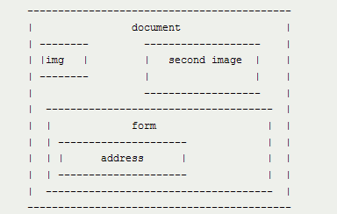
DOM – Accessing Elements
name=“theSecond”
name=“the first”

Slide 30
DOM – Accessing Elements
document.images:
  the first image can be accessed using
document.images['thefirst']
OR
document.images[0]

Slide 31
DOM – Accessing Elements
document.forms
  The same goes for forms.
  Suppose the form on the page has name="contactform", then you can reach it by these two calls:
document.forms['contactform']
document.forms[0]

Slide 32
DOM – Accessing Elements
But in the case of forms, you don't want to access just the form, but a specific form field.
for each form the browser automatically creates the array document.forms[].elements[] that contains all elements in the form.

Slide 33
DOM – Accessing Elements
The form above holds as first element an
  <input name="address">. You can access it by these four calls:
document.forms['contactform'].elements['address']
document.forms['contactform'].elements[0]
document.forms[0].elements['address']
document.forms[0].elements[0]

Slide 34
DOM – Accessing Elements
These four calls are completely interchangeable, it's allowed to first use one, then another. It depends on your script exactly which method of access you use.

Slide 35
DOM – Accessing Elements
Once you have correctly accessed a form field or an image through the Level 0 DOM, you can manipulate the field
example
document.images['thefirst'].src = 'another_image.gif';
x = document.forms[0].elements[0].value;

Slide 36
DOM – Accessing Elements
Advantages of using names vs numbers
  If you use names, your script will work even after your move around your form elements
  with numbers the script may break

Slide 37
DOM – Accessing Elements
Text box, text areas
  user_input = document.forms[0].textBoxname.value
  to change the value
  document.forms[0].textBoxname.value = “abc”;

Slide 38
DOM – Accessing Elements
Select boxes
  to access the value
  user_input = document.forms[0].selectName.value;
  to change the value or the selection
  document.forms[0].selectName.selectedIndex = 2;

Slide 39
DOM – Accessing Elements
Check Box
we need to know if the checkbox is checked
  document.forms[0].checkbox.checked
  returns true or false
to set it to checked
  document.forms[0].checkbox.checked = true

Slide 40
DOM – Accessing Elements
Radio buttons
Unfortunately it's not possible to see at once which radio button in a group the user has checked.
You need to go through all radio's and see which one's checked property is true.

Slide 41
DOM – Accessing Elements
Radio buttons: document.forms[0].radios
is an array filled with all radio buttons.
for (i=0;i<document.forms[0].radios.length;i++)
{
if (document.forms[0].radios[i].checked)
{
user_input = document.forms[0].radios[i].value;
}
}

Slide 42
DOM – Accessing Elements
To check a radio button, set it’s property checked to true:
document.forms[0].radios[i].checked = true;

Slide 43
Form methods and properties
JavaScript has a few built-in methods and properties for dealing with forms. Three of them are especially important:
submit a form by using the submit() method. To submit the first form on the page, do
document.forms[0].submit()
Please note that when a form is submitted by JavaScript the onsubmit event handler is never executed.
To reset the form, do

Slide 44
Form methods and properties
document.forms[0].reset() resets the form
Finally, you can change the ACTION of a form:
  document.forms[0].action = ‘page.html';

Slide 45
the “this” keyword
in JavaScript “this” refers to the owner
what or who is the owner?

Slide 46
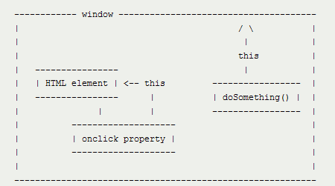
the “this” keyword

Slide 47
the “this” keyword
this always refers to the “owner” of the function we're executing, or rather, to the object that a function is a method of.
When we define a function doSomething() in a page, it’s owner is the page, or rather, the window object (or global object) of JavaScript.
An onclick property, is owned by the HTML element it belongs to.

Slide 48
the “this” keyword
function doSomething()
{
  this.style.color = '#cc0000';
  }
In the code above “this” refers to the window object.
But window does not have a style object. So the code
won’t work

Slide 49
the “this” keyword
Copying
we have to take care that the function that uses it is "owned" by the correct HTML element.
In other words, we have to copy the function to our onclick property. This is called Event registration
element.onclick = doSomething;
No parenthesis !
event registration

Slide 50
the “this” keyword
The function is copied in it’s entirety to the onclick property (which now becomes a method).
So if the event handler is executed this refers to the HTML element and it’s color is changed.

Slide 51
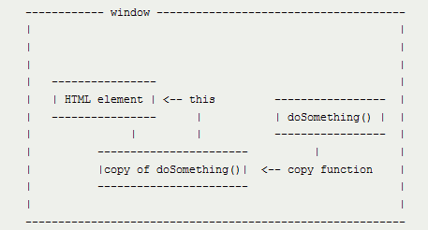
the “this” keyword
before element.onclick = doSomething;
after element.onclick = doSomething;

Slide 52
the “this” keyword
So what’s the advantage:
  we can copy the function to several event handlers. Each time this will refer to the correct HTML element
  Write the event handler only once
  Each time the function is called, this refers to the HTML element that is currently handling the event, the HTML element that "owns" the copy of doSomething().

Slide 53
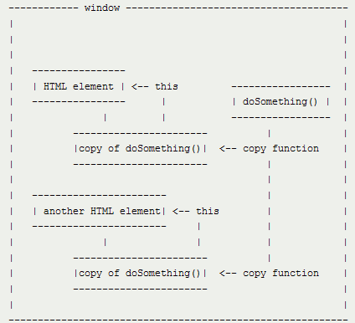
the “this” keyword

Slide 54
the “this” keyword
Referring
  However, if you use
  <element onclick="doSomething()">
  you do not copy the function!
  Instead, you refer to it, and the difference is crucial.
inline event registration

Slide 55
the “this” keyword
The onclick property does not contain the actual function, but merely a function call:
So it says “Go to doSomething() and execute it.”
When we arrive at doSomething() the this keyword once again refers to the global window object and the function returns error messages.

Slide 56
the “this” keyword
Another way of using the this keyword is
calling the function and sending a reference to self
  <element onclick="doSomething(this)">
provided that the doSomething function is expecting an argument

Slide 57
Working with HTML DOM
Find / accessing DOM elements
  by id - document.getElementById(“yourID");
  by tag name - document.getElementsByTagName("p");
  by class name - document.getElementsByClassName("intro");
  by CSS selectors - document.querySelectorAll("p.intro");
After finding DOM elements
  Traverse the DOM tree
  Set properties using methods
  Add/Remove child nodes
  Add event handlers

Slide 58
Adding/removing elements
  document.createElement(“div”) : lower case tag name
  document.removeChild(element) : element accessed
  Element.remove(): May not work on all browsers
  Document.appendChild(element)
  Document.replaceChild(new,old)
  Element.insertBefore(newNode, existingNode)

Slide 59
Traversing the DOM Tree
Use properties and methods of the Element object
  https://www.w3schools.com/jsref/dom_obj_all.asp

